Slide 1
DATA-DRIVEN PLAYER PERFORMANCE CLASSIFICATION USING ML TECHNIQUES
İSHAK ORÇUN AYDEMİR
UTKU ÖZYİĞİT

Slide 2
PROJECT OVERVIEW
Our Goal: To analyze Counter Strike player statistics and classify them based on performance using machine learning.
Our Steps:
Data Cleaning & EDA
Classification & Regression
Feature Selection (Random Forest)
Dimensionality Reduction (PCA)

Slide 3
DATASET OVERVIEW (PLAYER_STATS)
Dataset Info:
Shape: 1869 rows × 8 columns
No missing values
Features: name, country, teams, total_maps, total_rounds, kd_diff, kd, rating
Numerical Features:
total_maps, total_rounds, kd_diff, kd, rating
Target Variable for Classification:
rating ≥ mean → Good Player (1)
rating < mean → Bad Player (0)
Resulting in 938 good and 931 bad players

Slide 4
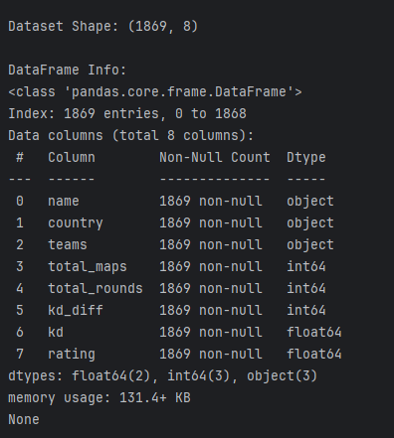
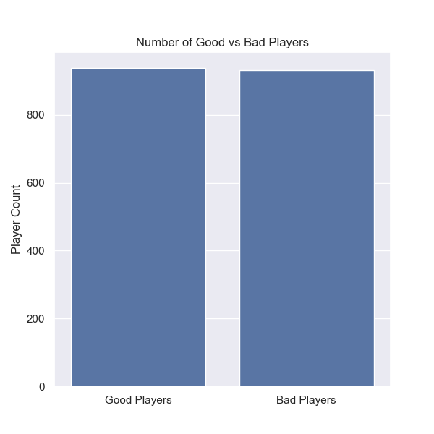



Slide 5
EXPLORATORY DATA ANALYSIS (EDA)
Rating Distribution Summary:
Mean: 0.9858
Max: 1.28, Min: 0.68
75% of players have rating ≤ 1.03
Top Players by KD:
sh1ro 1.43
deko 1.42
Zyw0o 1.38
Top Players by Rating:
ZywOo: 1.28
s1mple: 1.25
sh1ro: 1.22
Player Distribution by Country:
US: 204
Brazil: 138
Australia: 134

Slide 6
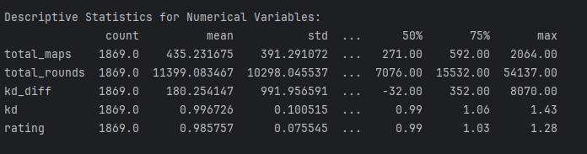
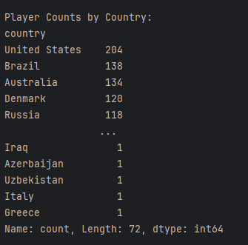
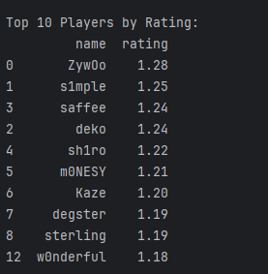
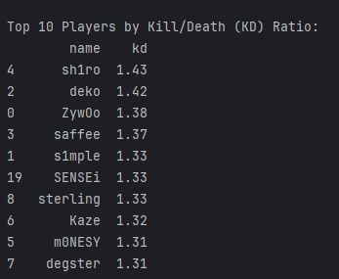

Slide 7
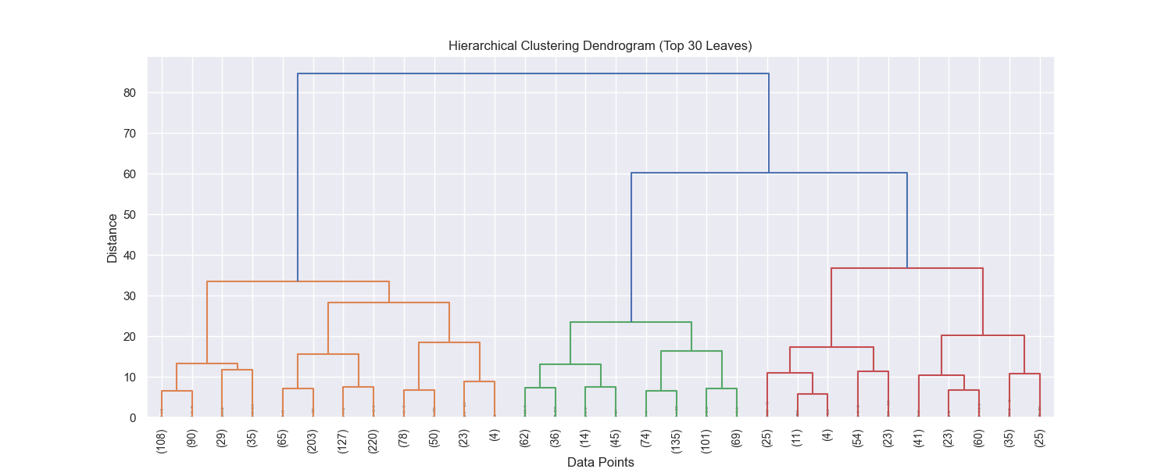
CLUSTERING DENDROGRAM
We visualized the hierarchical clustering based on similarity between players using a dendrogram. The X-axis represents the players (or clusters), and the Y-axis reflects the dissimilarity (distance) between clusters. Players that merge at lower points are more similar to each other. Using the Ward method, we created clusters while keeping the variance to a minimum. This allows the graph to help determine the meaningful number of clusters, and branches that merge higher up show player groups that are more distinct from each other.

Slide 8
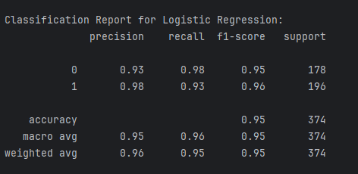
CLASSIFICATION – LOGISTIC REGRESSION
Model: Logistic Regression
Target: Good (1) vs Bad (0) players
Results:
Accuracy: 95%
Precision/Recall/F1-score: All above 0.93 for both classes
High performance even with a simple model.

Slide 9

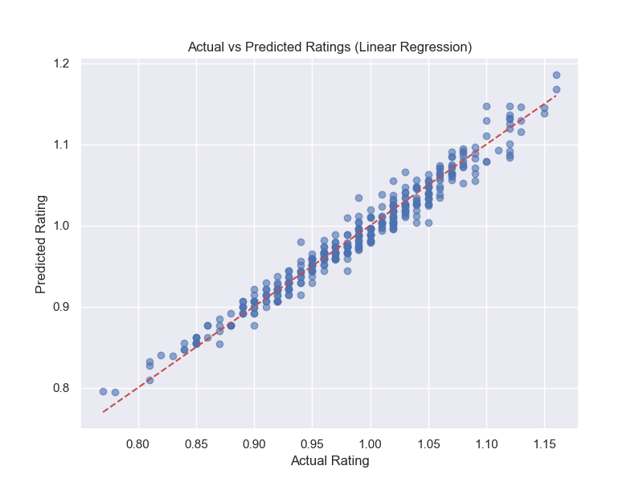
REGRESSION – LINEAR REGRESSION
Our Goal: Predict rating from other variables
Performance Metrics:
R² Score: 0.9646
MSE: 0.0002
Very good fit → Features explain 96% of variance in rating

Slide 10
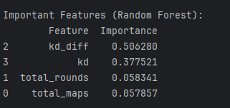
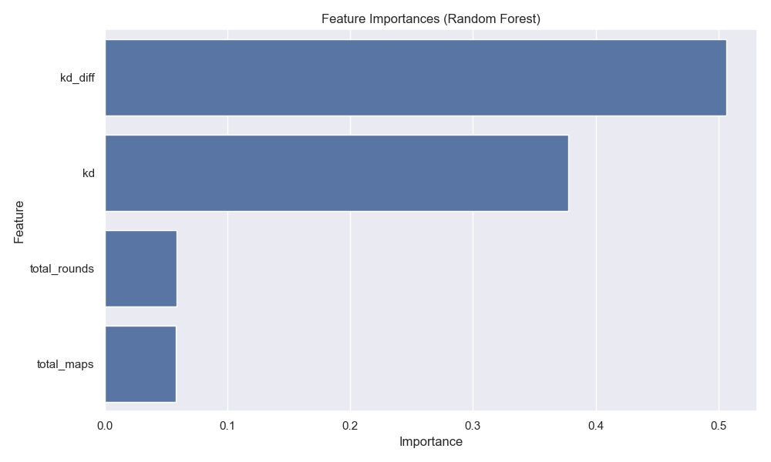
FEATURE SELECTION – RANDOM FOREST
Most Important Features:
kd_diff – 50.6%
kd – 37.7%
total_rounds, total_maps – ~5% each
KD-related features are most predictive

Slide 11
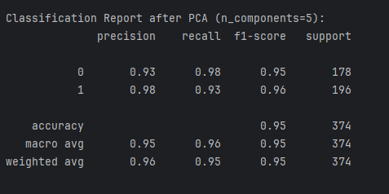
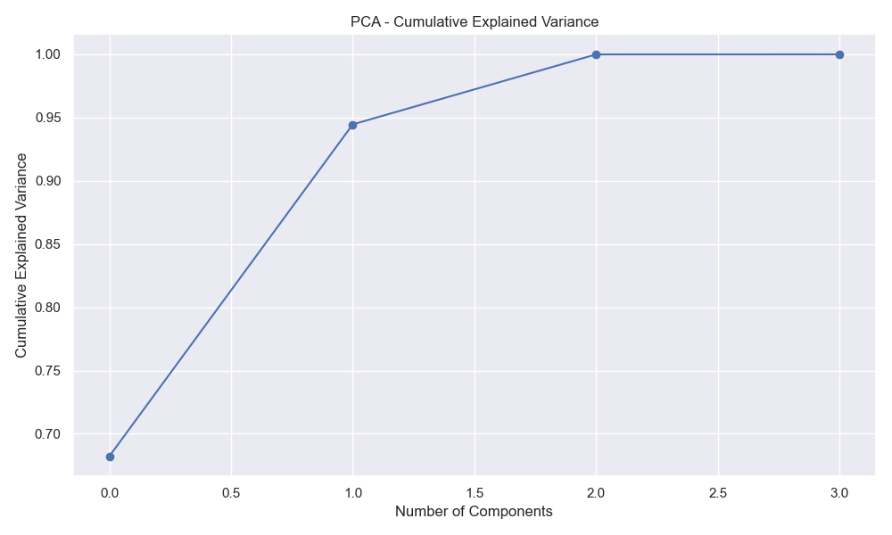
DIMENSIONALITY REDUCTION – PCA
PCA with n_components = 5
Preserved ~100% of variance
Classification Accuracy remained 95%
PCA did not degrade performance

Slide 12
CONCLUSION
As a result of our research and analyses, we observed that the number of players from Turkey in the dataset is quite low, and the number of high-performing players is also limited. The comparatively low number of players and teams coming from Turkey indicates that the professional e-sports infrastructure and player development opportunities in the country have not yet reached the desired level. In our analyses, we identified that the most important factors affecting players’ performance worldwide are the total number of matches played, total rounds played, and players’ kill/death (KD) ratios. However, we saw that players from Turkey do not rank high in these metrics, and therefore, their competitiveness on the international stage is not yet sufficiently strong. This situation reveals that there is a need to increase infrastructure investments and support talented players within the Turkish e-sports ecosystem. The development of skilled players and the activity of more teams will contribute to strengthening Turkey’s position in the e-sports arena. Additionally, increasing education, training, and organizations that support player development will be key to long-term success for the country. In summary, we believe this study shows that although Turkey has great potential in the e-sports scene, it currently lacks a sufficient number of players and team density. Strategic efforts are needed to address these deficiencies.

Slide 13
THANKS FOR THE LISTENING

